Slide 1
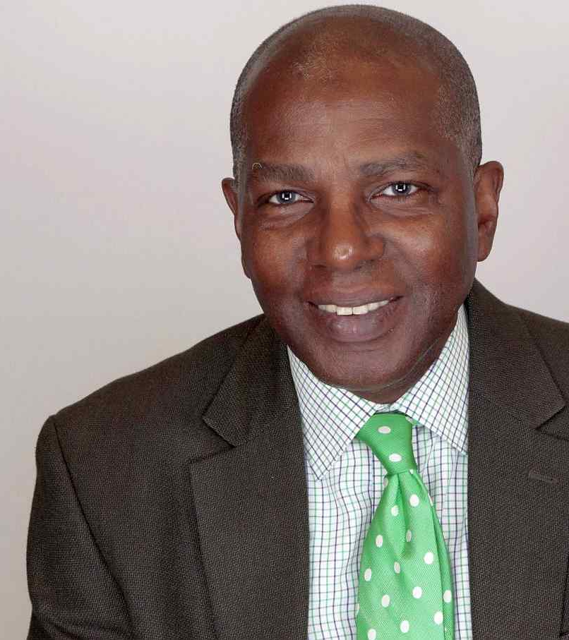

C R E A T I V E
INVESTMENT
RESEARCH
NAREB, Inc.
2021 Virtual Spring Policy Conference
The Economic Impact of the Pandemic on the Black Community
Reduce Damage, HR 2123, HR 2543, AI
William Michael Cunningham info@creativeinvest.com

Slide 2
Our economic models are based on our
December 26, 2016 forecast,
"Under any conceivable scenario, the current situation is very bad, and I mean toxic, for democratic institutions in general and for people of color specifically. Bottom line: our Fully Adjusted Return Forecast indicates that, over time, things will get much, much worse....."
From: “Trumpism” https://www.linkedin.com/pulse/trumpism-william-michael-cunningham-am-mba/
Copyright, 2021, WMC and CIR.
info@creativeinvest.com
Not for reproduction or distribution.

Slide 3
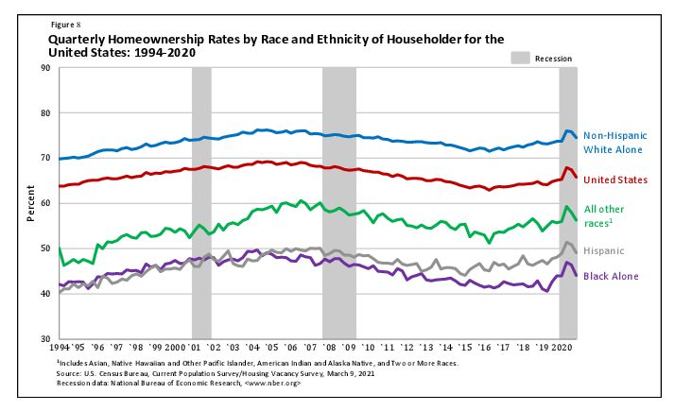
Minority Homeownership 1994 to 2020
Black homeownership remains at the lowest level. Meaningful, effective collaboration between minority groups unlikely, since they benefit from Black positioning.

Slide 4
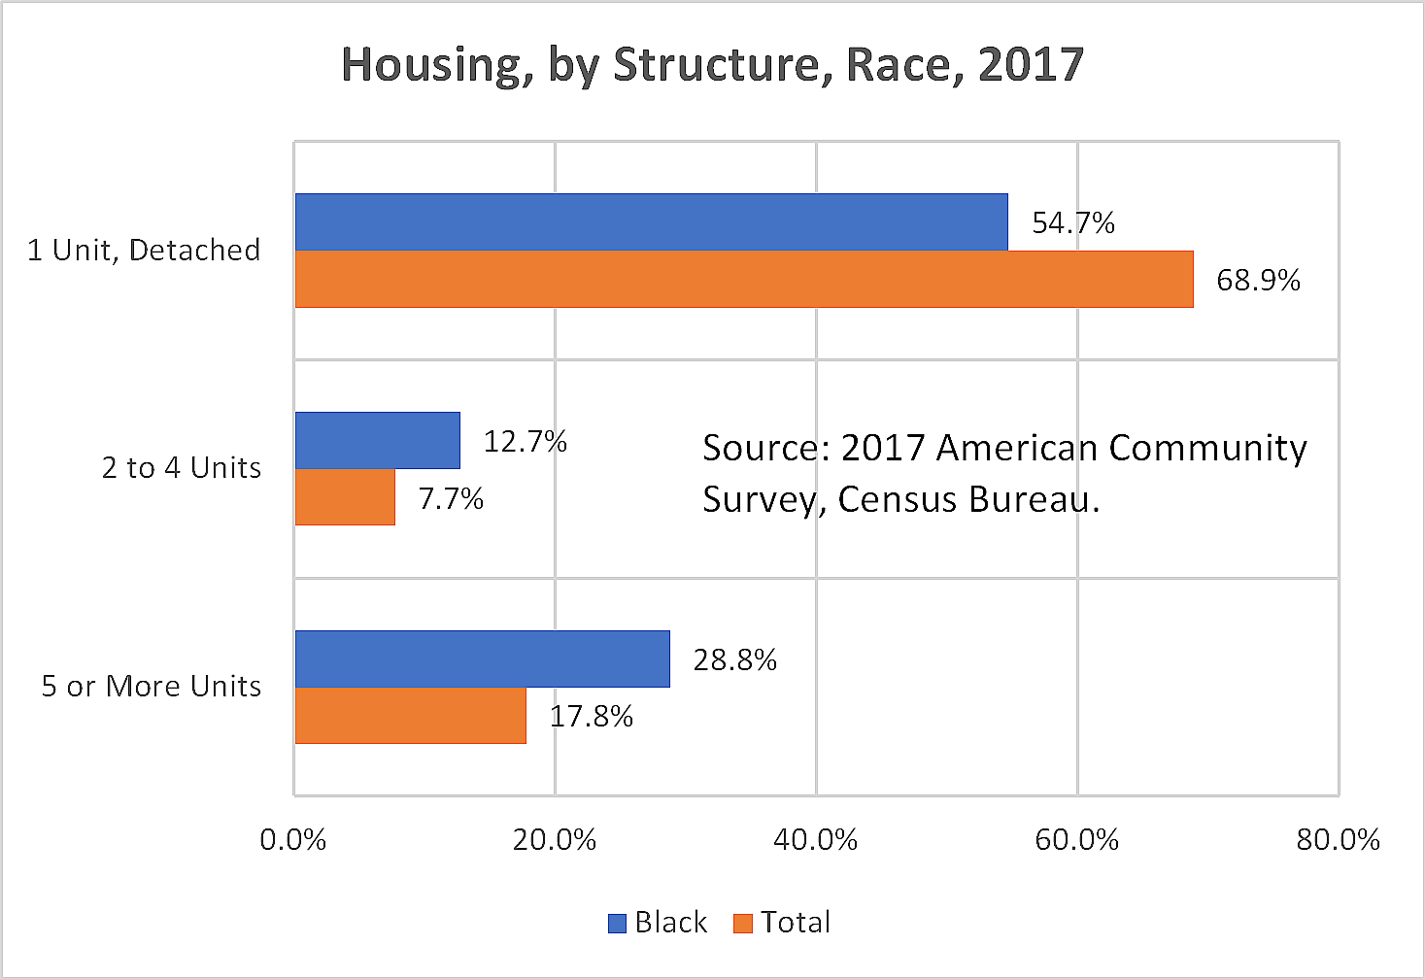
Housing by Residential Structure, 2017.
Since Black homeownership remains at the lowest level, we tend to reside in multifamily structures, increases infection risk during a pandemic.

Slide 5
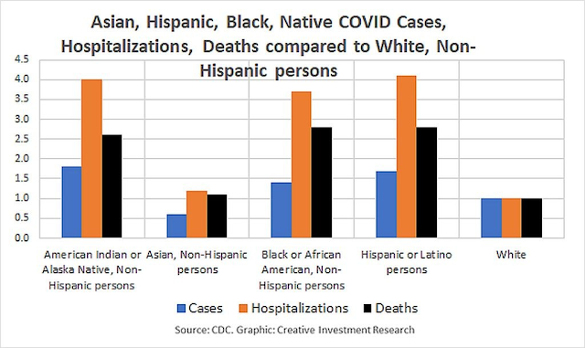
Minority COVID Cases 2020.
High death, infection incidents mainly due to failure of health care access. Black homeownership rates remains a factors, however.

Slide 6
HR 2123 and HR 2543
H.R. 2123 requires banks, money managers, brokerage firms, credit unions, and other regulated entities provide detailed diversity information. Allows a more diverse group of individuals at these entities to represent the interests of women and minorities, leading to further advancement in the fight to mitigate gaps in homeownership, employment, and overall financial stability.
H.R. 2543 amends the Federal Reserve Act to modify monetary policy goals implemented by the Federal Reserve. The Fed will operate in “a manner that fosters the elimination of disparities across racial and ethnic groups with respect to employment, income, wealth, and access to affordable credit.”
NOTE: New Zealand’s Central Bank will take into account the Government’s objective to support more sustainable house prices, “including by dampening investor demand for existing housing stock to help improve affordability for first-home buyers.”
Copyright, 2021, WMC and CIR. info@creativeinvest.com. Not for reproduction or distribution.

Slide 7
“I never saw no miracle of science that didn't go from a blessing to a curse…” Sting - If I Ever Lose My Faith in You
AI and Blacks
AI mortgage systems unlikely to provide true solution, since racist behavior embedded in data use to train AI systems.
Better solutions: Digital currency based cooperative lending products, Energy Efficient Mortgage MBS. https://www.creativeinvest.com/EnergyEfficientMortgageMBSJune2006.pdf

Slide 8

Copyright, 2021, WMC and CIR.
info@creativeinvest.com
Not for reproduction or distribution.
Health
Coronavirus
Impact
on
Black
People
6
Employment
Months left in 2021
Homeownership
30
Weeks left in shutdown (9/11).
Will be longer for Black people.
Small Business
Education
Sector
Impact
L/R Impact
Comment
Importance
Critical
Employment
Stimulus, BLM significantly positive.
Last hired, second fired in crisis
N
50%
75%
Homeownership
Major opportunity, but prices, financing remain issues
20%
Need HUD, FRB to help
20%
N
Health
High incident, death rates
75%
Most critical factor
95%
Y
Small Business
High closure rates but falling
40%
Given survival skills, lower
30%
N
x
Education
Lingering negative impact
80%
Best opportunity for a fix
85%
Y

Slide 9
"The COVID crisis reveals what’s actually important: health, family, and community. It also shows what’s not important: money worship and materialism. Globalization, a specific form of money worship, proved unable to support the domestic production of basic but critical supplies, like masks, in a time of crisis.”
From: COVID Reveals What’s Actually Important. December 6, 2020. https://www.linkedin.com/pulse/covid-reveals-whats-actually-important-cunningham-am-mba/
Copyright, 2021, WMC and CIR.
info@creativeinvest.com
Not for reproduction or distribution.

Slide 10
Wealth and the Black Community
Wealth maximization is the wrong goal.
Focus on life maximization. Why?
A materialistic focus will never work in a society that does everything it can to deny material comfort to black people.
Solution is to realize that wealth, in this culture, is a proxy for life.
BUT, in actuality, wealth life. (“There is no spoon.”)
Black people are experts at survival and life maximization in the most continually hostile environment on earth.
THIS, not money, is your legacy.
Copyright, 2021, WMC and CIR. info@creativeinvest.com. Not for reproduction or distribution.

Slide 11
What Now for Black People?
Assume we are Never Going Back to “Normal”
Focus on the Human, not the monetary
Pivot: cooperation, not competition.
Copyright, 2021, WMC and CIR. info@creativeinvest.com. Not for reproduction or distribution.

Slide 12
Black people need a truly collaborative and cooperative effort — in and by the Black community — a community often trained to be cutthroat to each other given the paucity of resources at its disposal. After Creative Investment Research, in the public spirit, disseminated an estimate of corporate pledges to the Black Lives Matter cause (at $1.6 billion), several foundations made donations totaling $1.7 billion.
Now is the time to let go of bad habits for the survival of the Black community. In so doing, we show the world the way out of the crisis. From: “Black Communities Need More Help from the Fed.” The American Banker Newspaper. July 7, 2020.”
Copyright, 2021, WMC and CIR. info@creativeinvest.com. Not for reproduction or distribution.

Slide 13
What now for NAREB?
Hire Black people. Period. What Black people? Hire Black women. Why? Social impact highest. Driving force for social and economic justice in the US.
Provide authentic support to members, employees, customers
Lower the return from racist behavior. Whites receive psychic income from racist behavior targeting African Americans. This compensation lessens their need to maximize income in other ways. Increase white wages.
Do business with Black, not “minority” firms
Create a $100 billion HUD/FRB Black Housing EEM Fund. Use Fannie, Freddie, GNMA, FHA/VA as part of this process. Address appraisal issues, other factors. See: https://www.americanbanker.com/opinion/black-communities-need-more-help-from-fed
Copyright, 2021, WMC and CIR. info@creativeinvest.com. Not for reproduction or distribution.

Slide 14
Thank you!
William Michael Cunningham
C R E A T I V E
INVESTMENT
RESEARCH
info@creativeinvest.com
www.creativeinvest.com
202-455-0430

Slide 15
Copyright and Confidentiality Notice
This communication (including all pages in this document) are for the sole use of the intended recipient and may contain confidential information. Unauthorized use, distribution, disclosure or any action taken or omitted to be taken in reliance on this document is prohibited, and may be unlawful. By inadvertent disclosure of this document Creative Investment Research and William Michael Cunningham do not waive confidentiality privilege with respect hereto. This writing/publication is a creative work fully protected by all applicable copyright laws, as well as by misappropriation, trade secret, unfair competition and other applicable laws. No copyright is claimed in the text of statutes, regulations, and any excerpts from others’ reports or articles quoted within this work. Copyright©2021 by William Michael Cunningham and Creative Investment Research. All rights reserved – including the right to reproduce in whole or in part in any form.

